Slide 1
Final Report
114323115 簡翌玹
114323104 沈鈵芫
Date: Dec 18, 2025
ME5071 Fundamental Theory and Engineering Application of Machine Vision

Slide 2
1/13
Observations
Model becomes difficult to converge in mid-to-late stages when using DANN.
Generalization performance on the target domain remains low.
Approach
Using a hybrid T-S and DANN architecture, we distill YOLO’s knowledge to guide the model in learning YOLO-like behavior within the target domain.

Slide 3
2/13
Datasets
We didn’t use the cleaned up dataset, but using full version that released below the "10/16 final project" announcement
Dataset1
Dataset2
Baselines
Baseline1:
YOLO11n-seg trained on the source domain
Baseline2:
YOLO11x-seg trained on the both source and target domain

Slide 4
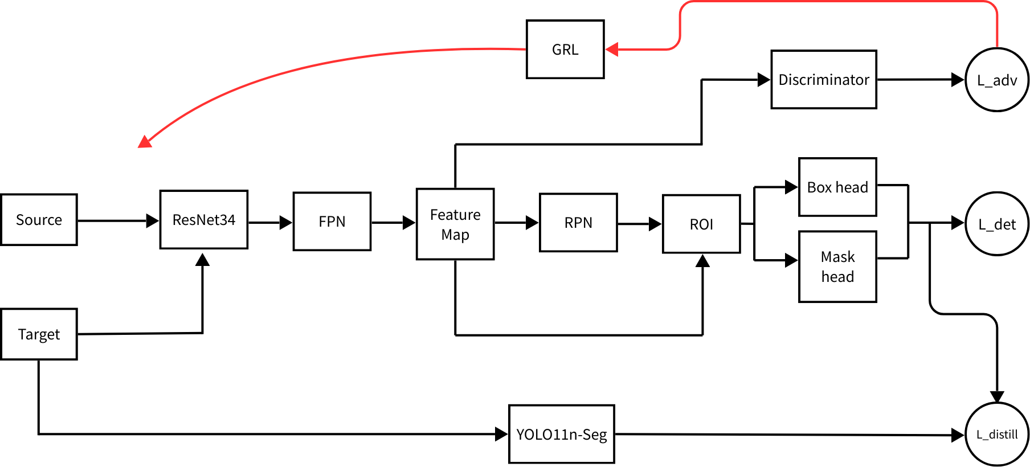
Architecture
3/13

Slide 5
4/13
Teacher Model
YOLO11n-seg trained on the source domain

Slide 6
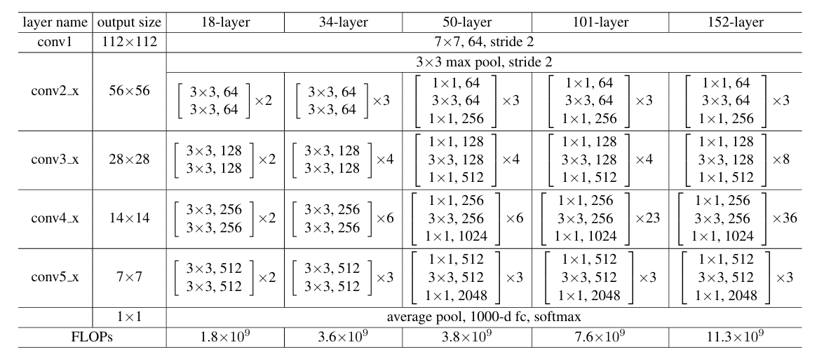
5/13
Student Model
Mask-RCNN (ResNet34 backbone) with domain discriminator

Slide 7
6/13
Student Model
Gradient Reverse Layer
Reverse Gradient to forced feature extractor generate domain-invariant feature.
Domain Discriminator
Source Domain
Feature
Conv2d
x2
Linear
Target Domain

Slide 8
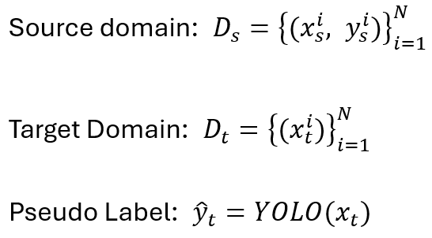
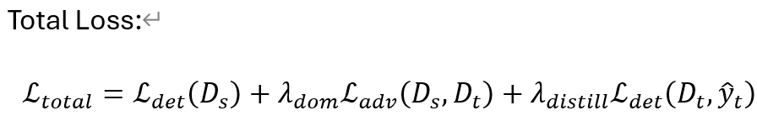
7/13
Loss Function
MaskRCNN
binary cross entropy
cross entropy

Slide 9
Data Pre-processing
8/13
Data Pre-processing through torchvision.transforms
Random horizontal flip (0.5)
Random vertical flip (0.5)
Color jitter:
brightness: 0.3
contrast: 0.4
saturation: 0.3
hue: 0.05
gaussian blur: 0.2

Slide 10
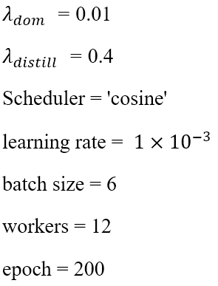
9/13
Hyperparameters

Slide 11
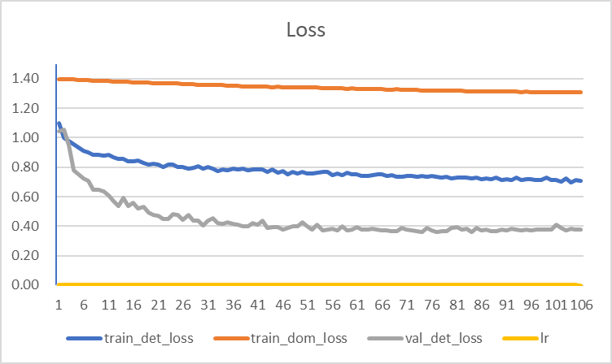
Results
10/13

Slide 12

11/13
Results
Random test set from roboflow
1. roboflow

Slide 13
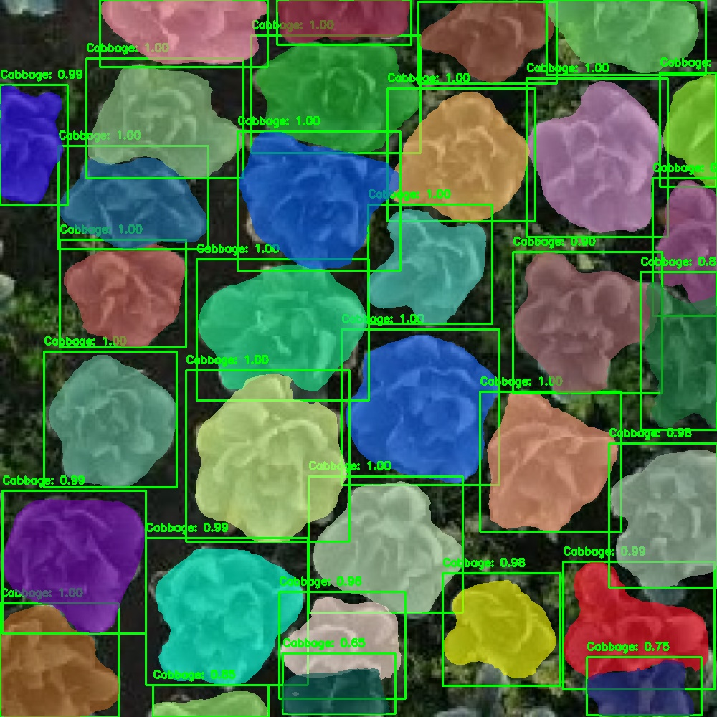
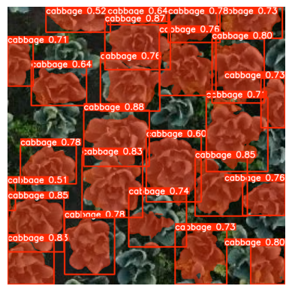
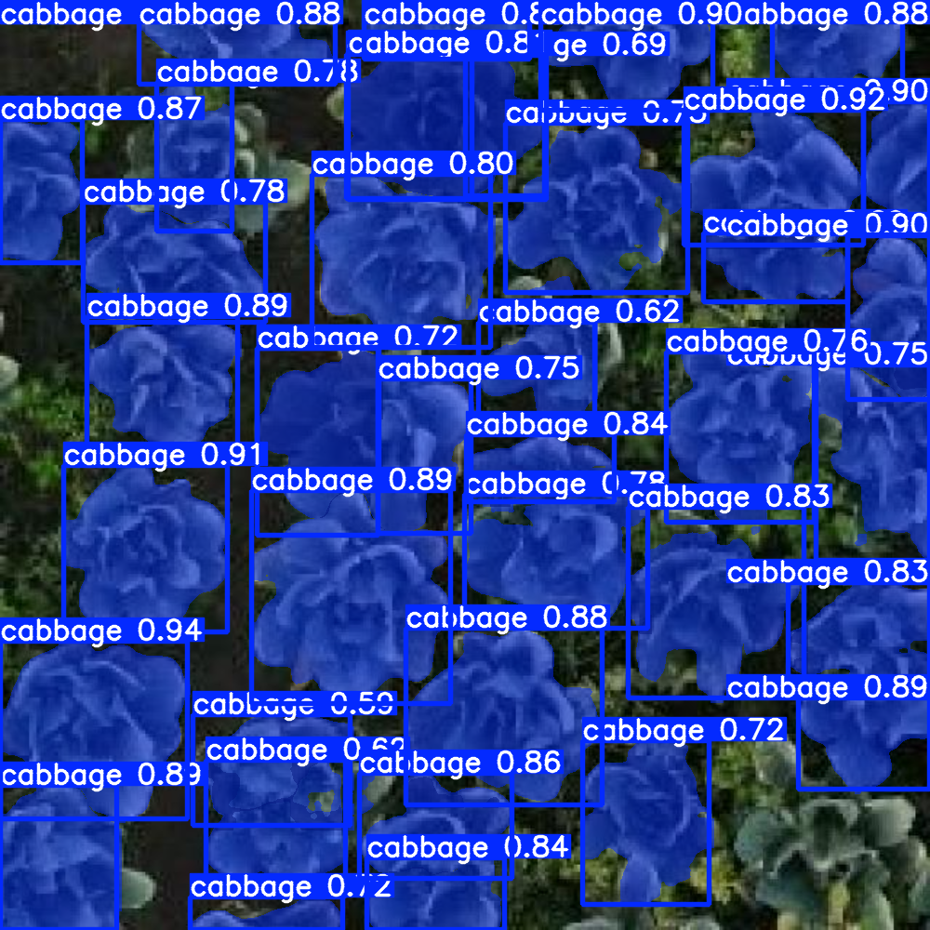
12/13
Results
Ours
Baseline1
Baseline2

Slide 14
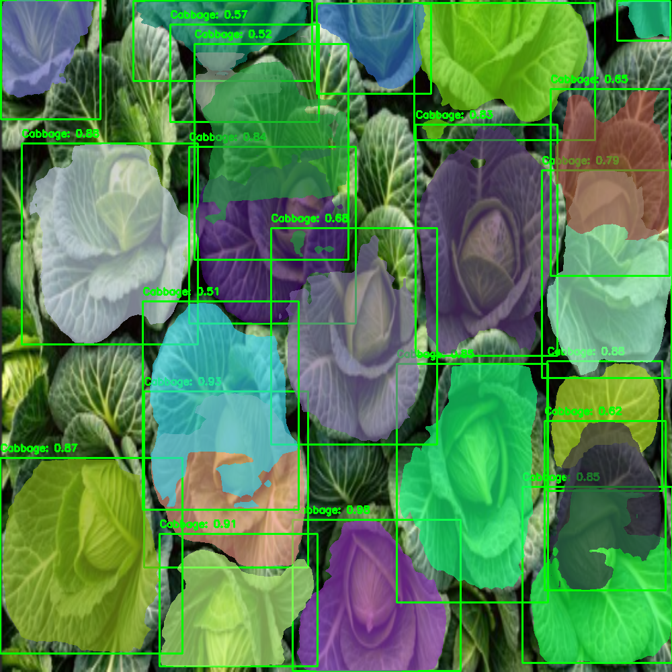
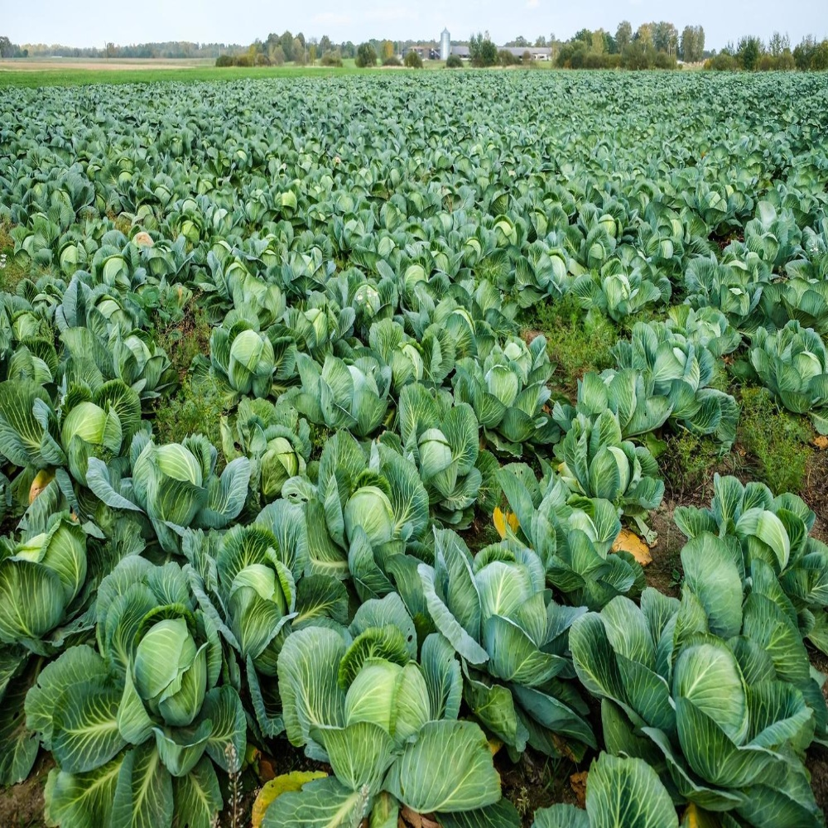
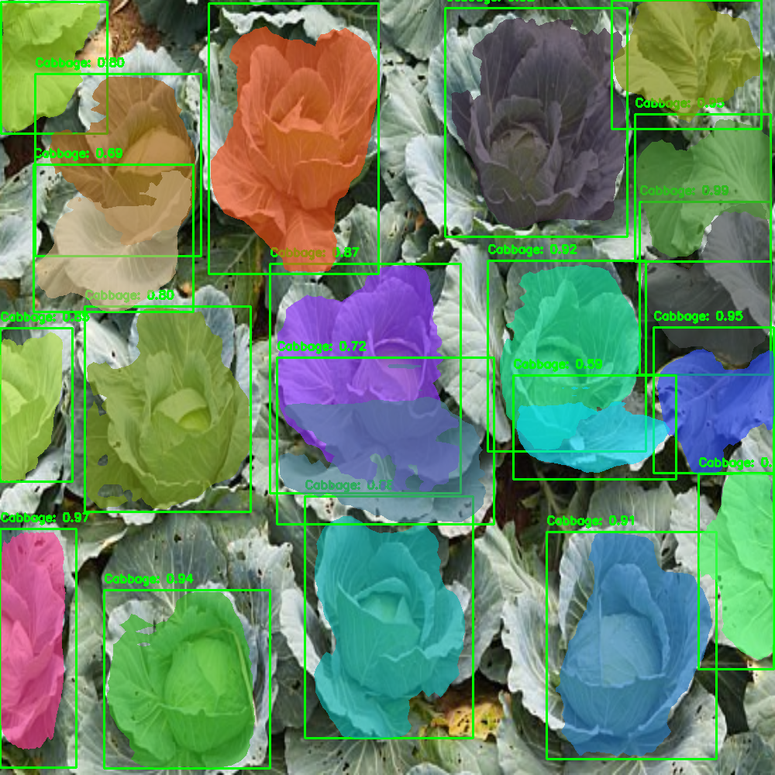
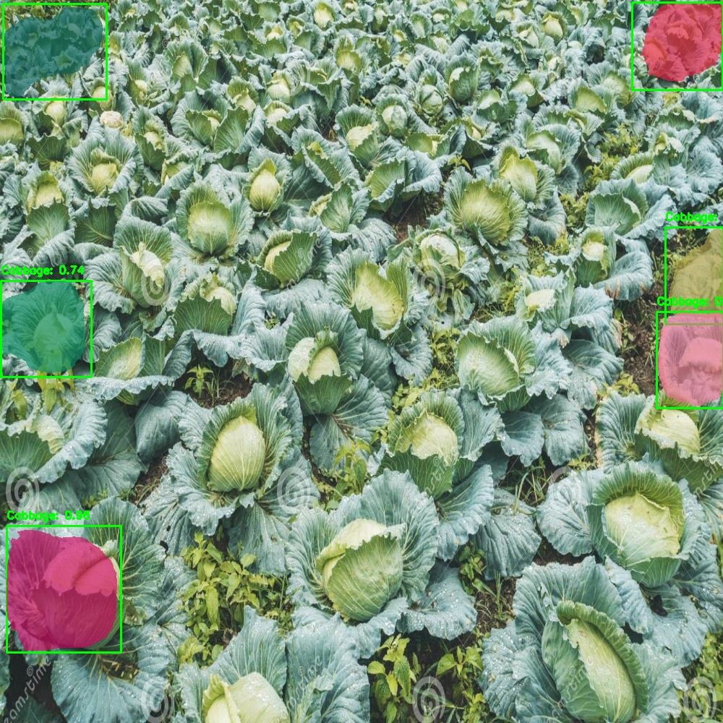
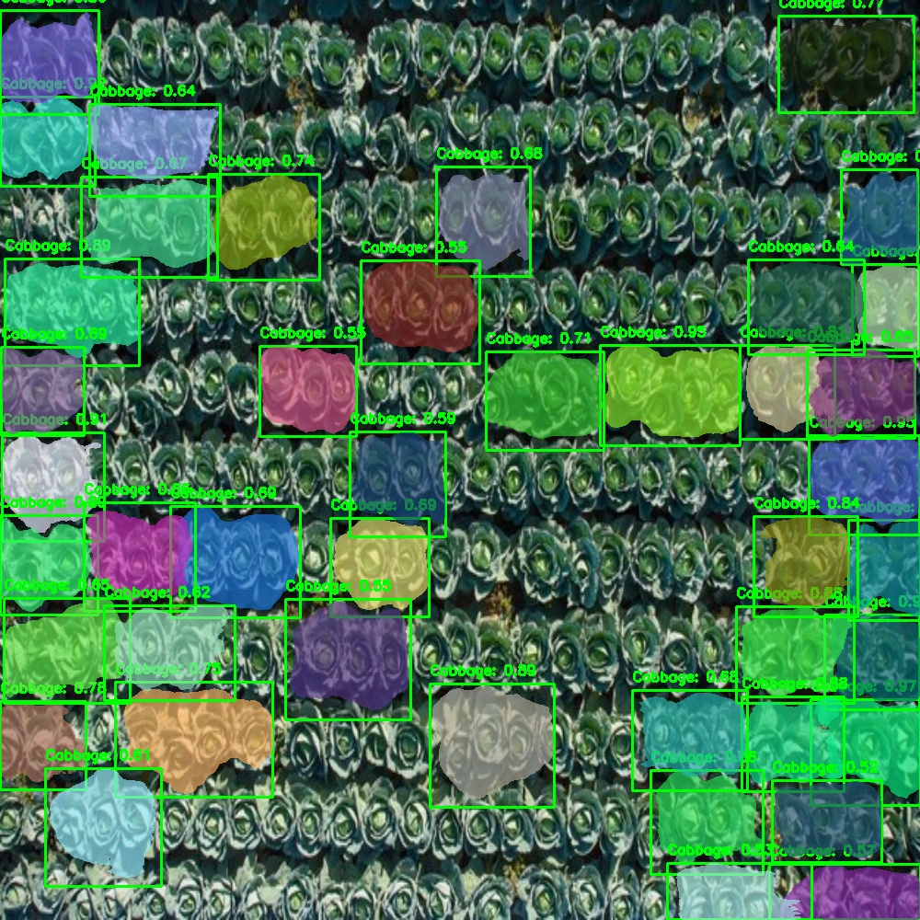
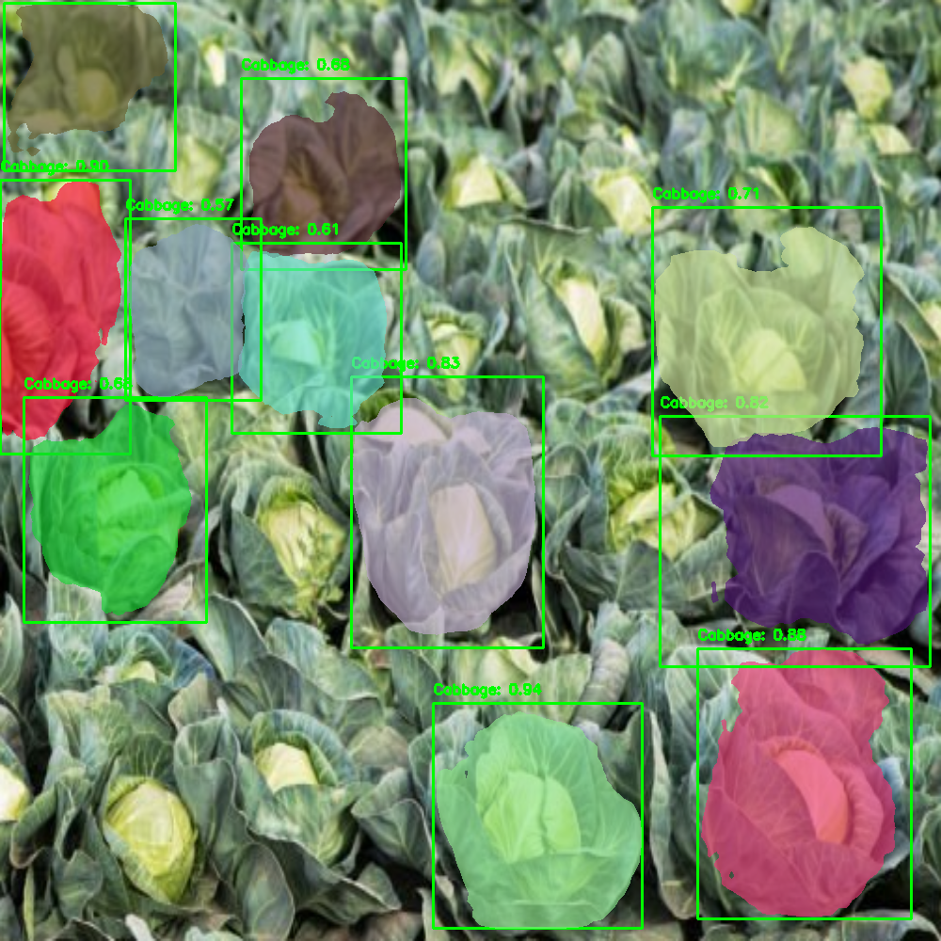
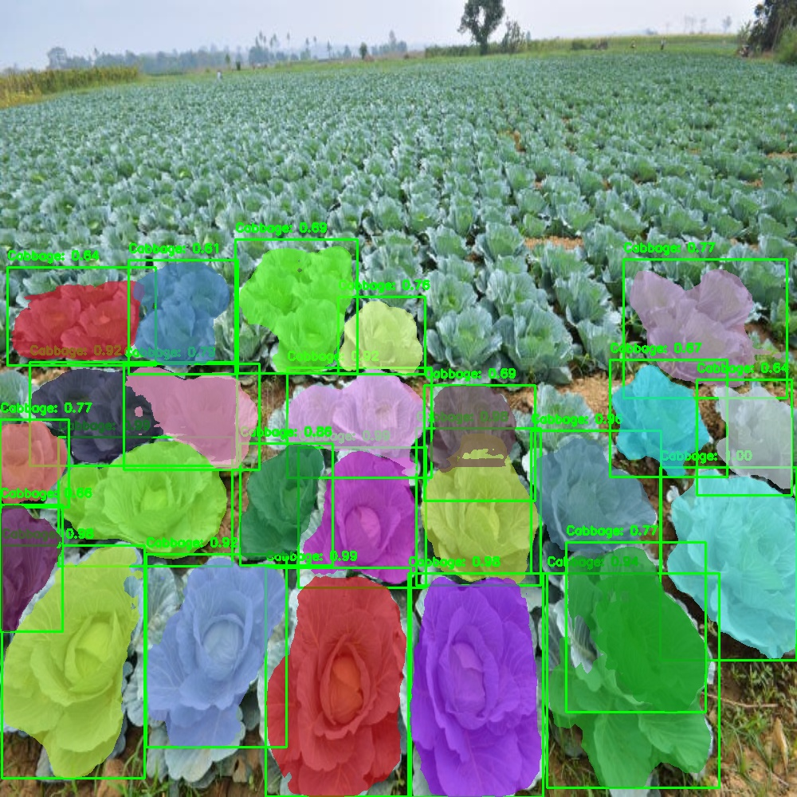
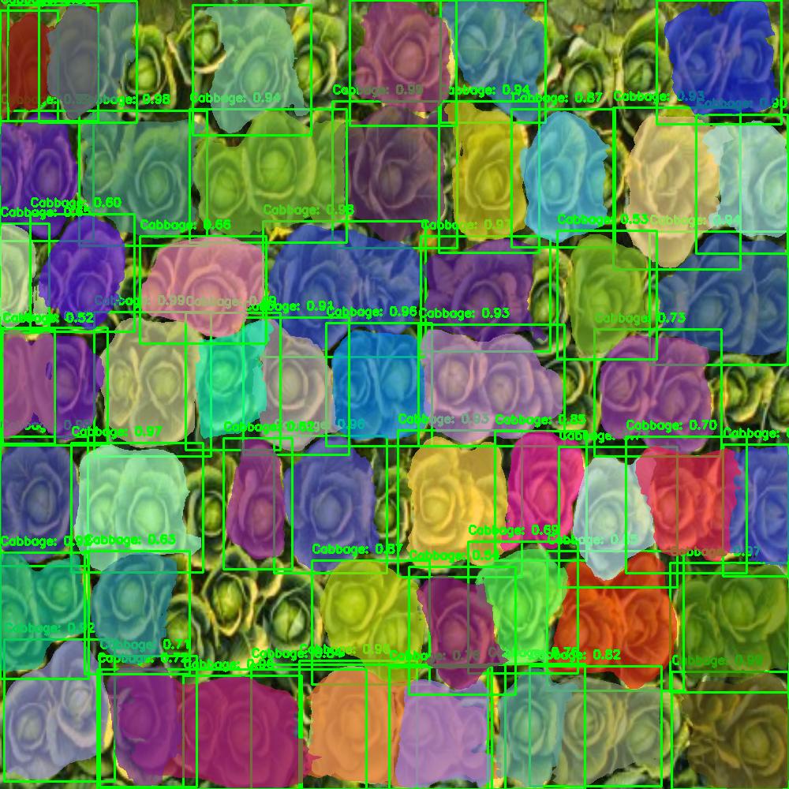
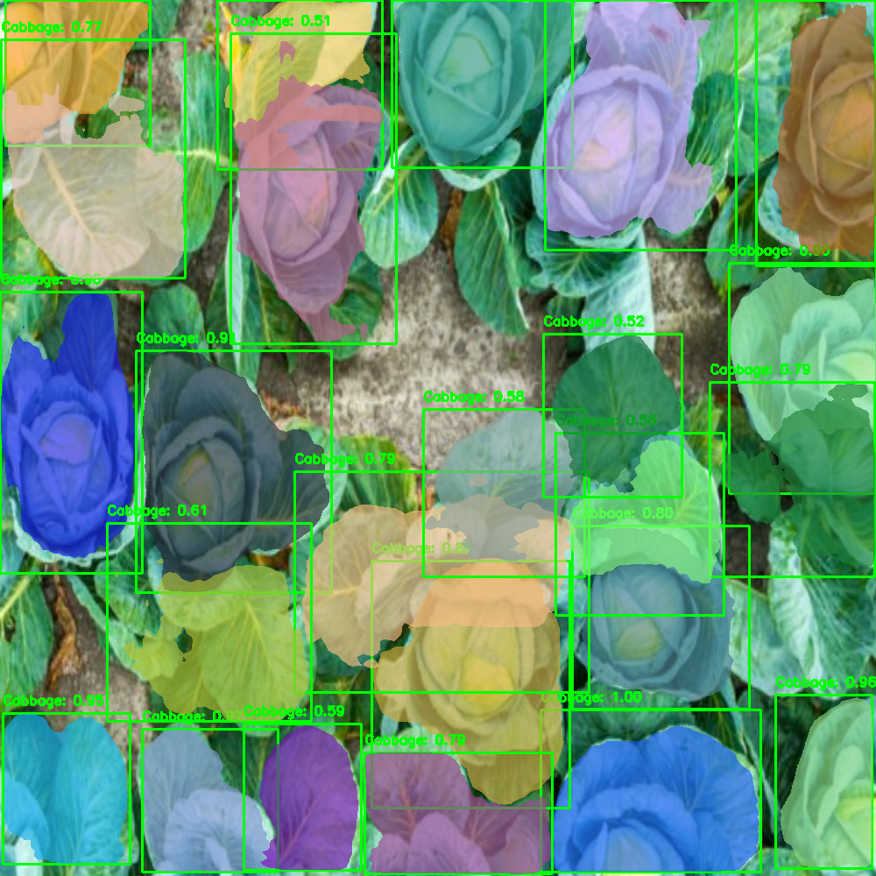
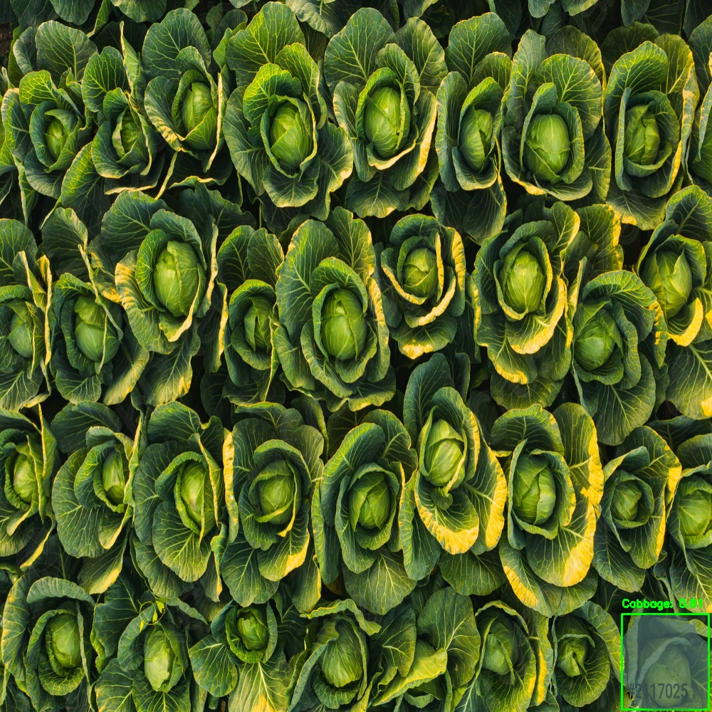
13/13
Results

